Slide 1


Presented By LG : 07
Analysis of Continuous Data Using SPSS
PREPARED BY
ROLL NUMBER
COURSE / SUBJECT
G. Harshitha
G.Hansika
Haseebuddin
Harshal
251U1R2074
251U1R2073
251U1R2040
Probability Theory and
Stastical Analysis

Slide 2







Introduction
Data Analysis
Continuous Data
Role of SPSS
The systematic process of inspecting, cleaning, and modeling data to discover useful information and support decision-making.
Numerical data that can take any value within a given interval, measured along a continuous scale with infinite precision.
A statistical software package providing automated tools for complex numerical calculations, hypothesis testing, and graphing.

Slide 3

Continuous Data
Key Characteristics
Real-World Examples
Represents numerical values that can be measured.
Contains infinite possible values within a scale range.
Can include fractional and decimal values.
Height (cm)
Weight (kg)
Measured using interval or ratio scales.
Temperature (°C)
Time (Seconds)

Slide 4





What is SPSS?
Statistical Package for the Social Sciences
Statistical Software
Data Management
Graphs & Testing
Industry-standard tool used worldwide by researchers and analysts for performing quantitative computations.
Effortlessly imports, transforms, codes, and organizes complex continuous datasets into structured spreadsheets.
Generates high-resolution statistical plots and performs inferential hypothesis tests with a few clicks.

Slide 5








Why Use SPSS?
Easy Analysis
Fast Calculations
Intuitive graphical interface allows execution of complex tests without coding.
Processes thousands of continuous data rows instantly, saving valuable time.
Accurate Results
Visual Graphs
Eliminates human errors in mathematical formula execution and statistical output.
Creates publication-ready histograms, scatter plots, and box plots seamlessly.

Slide 6
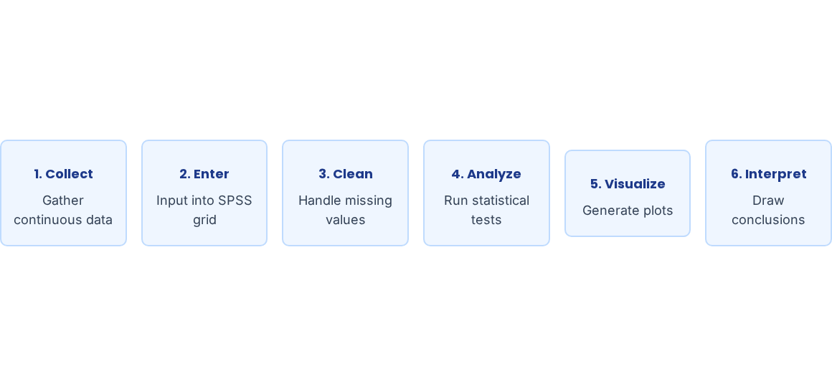
The Analysis Process

Slide 7


Data Entry in SPSS
SPSS View Modes
Sample Data View Window
Variable View: Define names, data types, decimals, and scale levels.
ID | Age (Years) | Height (cm) | Score (%)
001 | 21 | 172.5 | 88.0
002 | 22 | 165.0 | 92.5
003 | 20 | 180.2 | 79.0
004 | 23 | 175.8 | 85.4
Data View: Spreadsheet matrix containing actual raw values.
Rows = Cases: Represents individual participants or units.
Columns = Variables: Represents measured parameters.

Slide 8






Descriptive Statistics
Mean
Median
The arithmetic average of all values in a continuous dataset.
The exact middle value when data is sorted in ascending order.
Standard Deviation
Min & Max
Measures how much individual data values spread out from the mean.
The smallest and largest observed values in the variable spectrum.

Slide 9




Mean & Median
Core Concepts
Simple Calculation Example
Mean (Average)
Sum of all values divided by total count of cases.
Median (Middle Point)
50th percentile mark; splits data into two equal halves.

Slide 10
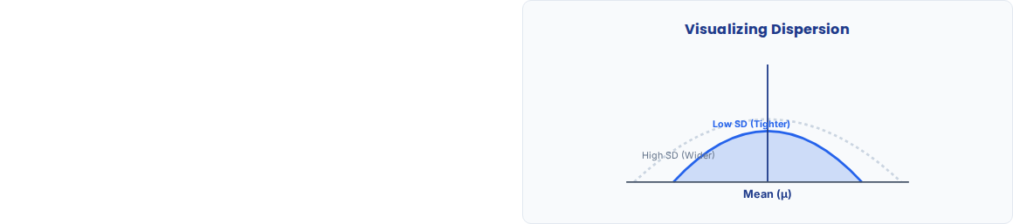
Standard Deviation
Understanding Data Spread
Quantifies the overall dispersion or variability around the mean.
Low SD: Data points are clustered tightly near the mean.
High SD: Data points are spread widely across a broader range.

Slide 11






Graphical Analysis
Histogram
Box Plot
Scatter Plot
Visualizes frequency distribution and checks whether continuous data follows a normal bell curve.
Displays 5-number summary (median, quartiles) and detects extreme outlier points.
Illustrates relationships, trends, and correlations between two continuous variables.

Slide 12
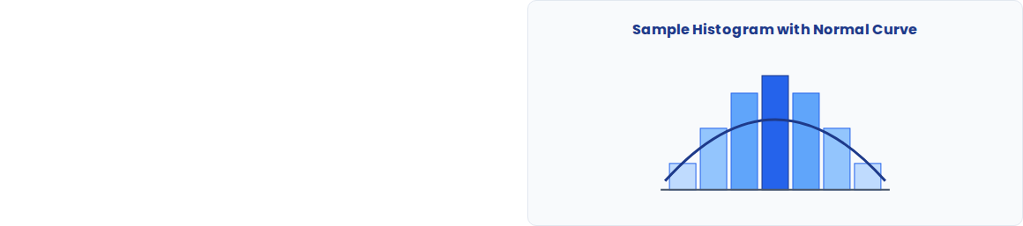
Histogram Analysis
Purpose & Features
Shows shape of data distribution.
Helps identify patterns (skewed vs symmetric).
Essential for checking Normality Assumption before running statistical tests.

Slide 13
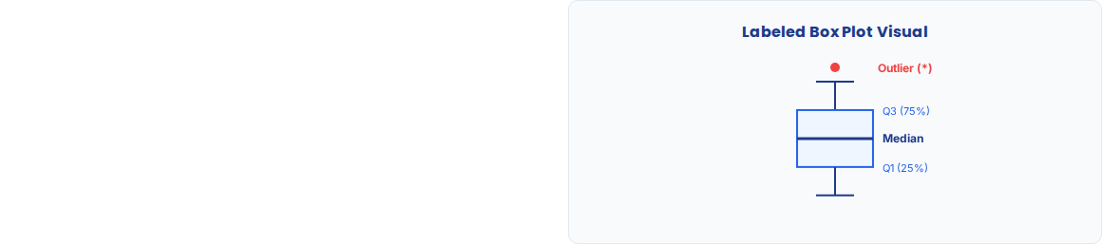
Box Plot & Outliers
Box Plot Features
Displays five-number statistical summary.
Shows median line inside the central box (IQR).
Outliers: Points positioned beyond whiskers (extreme values).

Slide 14
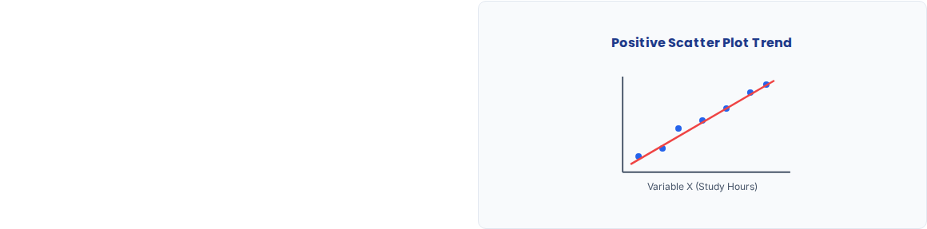
Correlation Analysis
Pearson Correlation Coefficient (r)
Measures strength and direction of linear relationship between two continuous variables.
Value ranges from -1.0 to +1.0.
+1.0: Perfect positive linear correlation.
-1.0: Perfect negative linear correlation.
0.0: No linear correlation exists.

Slide 15



SPSS Practical Example
Research Scenario
Question: Does study time affect exam marks?
Sample SPSS Output Table
Correlations | Study Hours | Exam Marks
Pearson (r) | 1.000 | 0.780**
Sig. (2-tailed) | - | 0.003
N (Sample) | 30 | 30
Continuous Variables:
1. Study Hours (Independent)
2. Exam Marks (Dependent)
Interpretation: Strong positive correlation (r = 0.78, p < 0.05).

Slide 16







Conclusion
SPSS simplifies continuous data entry and processing.
Descriptive statistics summarize data central tendencies.
Histograms and Box Plots reveal key distributions.
Correlation tests quantify linear relationships.
Thank You!
Questions & Answers

Slide 17


Thank You!!!

